Slide 1
Sovereign Practice Newsletter
An update from Dr Jonathan Andrews – Senior GP Partner
On 3rd July I passed the 28th anniversary of me starting work as a fresh faced GP with Dr Forster and Partners in what was then the Winifred Lee health Centre.
In that 28 years there has been an enormous number of changes in the NHS. Medicine has become very much more complicated and General Practice has been handed a lot more community based work to do including screening and disease prevention as well as looking after people that are unwell.
At Sovereign Practice (as we are now known) we have 3 full time and one half time Partners, 3 full time salaried Doctors and 4 part time salaried/long term locum Doctors. Most of the time we have 2 trainees who are fully qualified Doctors still training to be specialists either in Hospital or as GPs.
To support us we have a fantastic team of Managers, Nurses, Administrators and Receptionists. We also have a number of additional services running alongside us such as pharmacists, physios, X-ray/ultrasound and DEXA scanning, retinal screening, abdominal aortic aneurysm screening to name a few.
Between us we look after over 15500 patients registered with the Practice.
As you will now understand this is a big and complex organisation and a great deal of effort goes into the smooth running of our services. The biggest challenge we have is in meeting the demand for those services. At times, we simply don’t have enough appointments available for everyone that would like one. This is not because we are not working hard enough. It is simply that we have reached capacity. My average working day is 11 hours long and will include as well as seeing patients face to face; dealing with on-line consultations, home visits, telephone appointments, calls and emails from other health professionals, dealing with letters from the hospital Doctors, checking laboratory results, signing prescriptions, clinical meetings and management meetings. So if you see me sitting in my room on my own, it is not because I am just twiddling my thumbs!!
Every day is different and challenging in its own way.
We know it can be frustrating trying to get an appointment and our Reception team try as hard as they can to accommodate and help everyone that calls. They have to deal with a lot of complex issues and help patients to navigate the local health services. For many years, General Practice has not been commissioned or funded to be an emergency service and so when we are full to capacity, if an emergency arises, the reception team will advise patients to attend the Urgent Care Centre at the Hospital or go to A/E.
I wish to stress that everyone at Princes Park Health Centre is striving to do our very best to help our patients often under significantly challenging circumstances. We are all humans ourselves and have families and lives outside of our working lives. Please can everyone remember this and be kind to all members of staff whenever you call or come to the surgery.
It has been an honour to be a GP in Eastbourne for so long and I am very lucky to work with a great team around me. I hope we serve you all well.

Slide 2
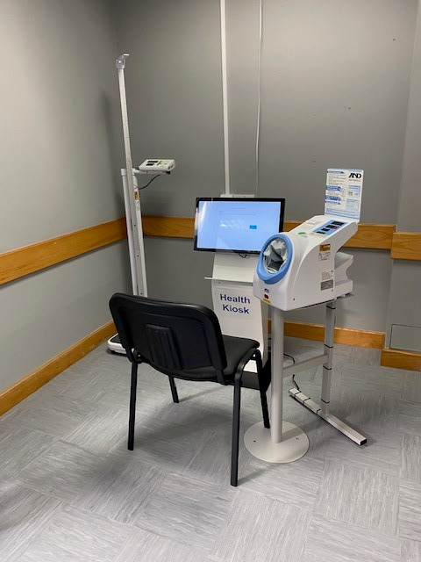
Slide 2
Appointments, Engage Consult & Enhanced Access
Engage Consult, which is accessible via our website is a 2 way messaging service that covers admin queries and any medical queries, it is not a platform for booking appointments. We are always looking at ways we can improve the practice. We upgraded our telephone system at the beginning of the year. It now places patients in a queue, advising them of what number they are in the queue. We have a call back option but we cannot guarantee that any appointments will still be available as we receive such a high volume of calls. We now offer 5 (book on the day) face to face appointments which the reception team are able to book directly in to rather than all appointments being put on the telephone triage list first, this is subject to the patient meeting specific criteria. The Partners have created a criteria for what conditions can be booked in. This includes; very frail, elderly & vulnerable patients, patients with abnormal lumps, patients needing a steroid injection, patients with rapid weight loss, patients who are deaf and children under 5 years old are on the list. We now offer 3 emergency appointments for each GP and 3 pre bookable appointments. We have also started using a self-book system. This means that GP’s can now send out a text message to their patients who need to book in for a blood test. It will give the patient the option to book themselves in for a blood test up to 21 days after the message has been sent.
Each GP manages their telephone appointments, they will offer the patient a face to face appointment on the day if they feel the patient needs to be seen. We offer Enhanced Access appointments on a Wednesday & Friday evening from 6.30pm – 8pm. We are also open one Saturday in 5 (rotating with our other primary care network practices). We have been fortunate enough to find a further 3 GPs to work at the practice. The practice is doing its very best to recruit additional GPs. We currently have up to 9 GPs available on specific days.
Once all of our appointments have gone, the reception team will advise to contact 111, attend the urgent treatment centre, visit a community pharmacy as they are also trained to offer appropriate treatment wherever possible. The reception teams will also ask if another clinician, such as a nurse or first contact practitioner would be suitable.
Health Kiosk
We now have a health kiosk in our waiting room. You can use it whenever you like. It takes your blood pressure, your height and weight & has a variety of health questionnaires. If you have been asked to provide a blood pressure reading & do not have a monitor at home, you are welcome to use the health kiosk

Slide 3
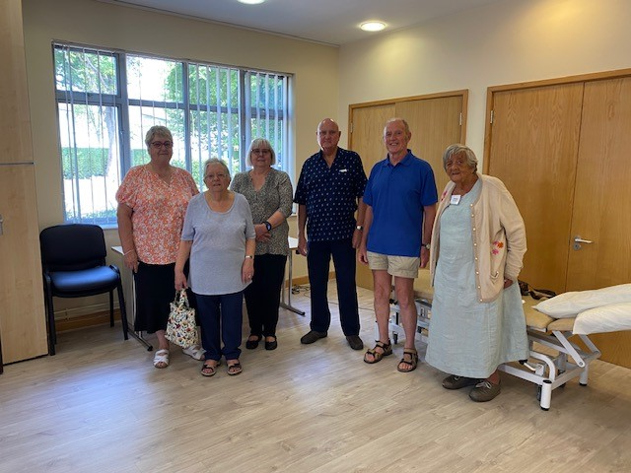
Slide 3
Meet our PPG
A Patient Participation Group (PPG) is a group of patients, carers and GP practice staff who meet to discuss practice issues and patient experience to help improve the service. Our aim for the PPG is to involve participants in shaping the practice to ensure we deliver health care services effectively in a safe and a caring environment that is responsive to patients needs in a well led manner. Our PPG usually meets on the second Tuesday every two months. In July we organised a coffee morning at the Practice with representatives from the Police, the Fire Brigade, the MS Society, the Samaritans and Dementia Uk which was very well attended and helped to inform patients of support available. Following on from the success of that coffee morning we’re already planning our next event for 22 November, please watch out for details to follow. We are looking for new members to join us. It is very important that the patients of the Practice have a voice and to help support the practice. We are not members of staff but ordinary people who are registered with the surgery. We strive to improve communications between patients and practice, share information, provide feedback from patients and explore their changing needs. If you want to join us please leave your contact details at reception and a member of the group will be in touch.
Friends and Family Test – latest results

Slide 4
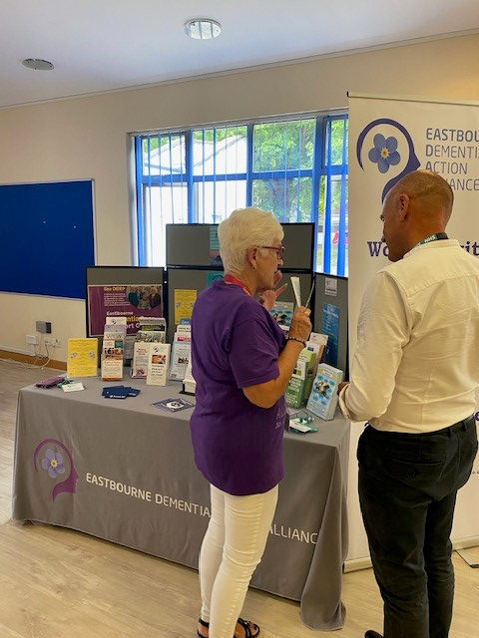
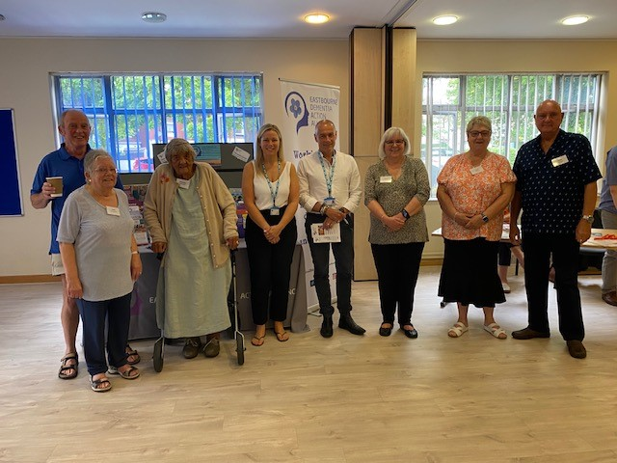
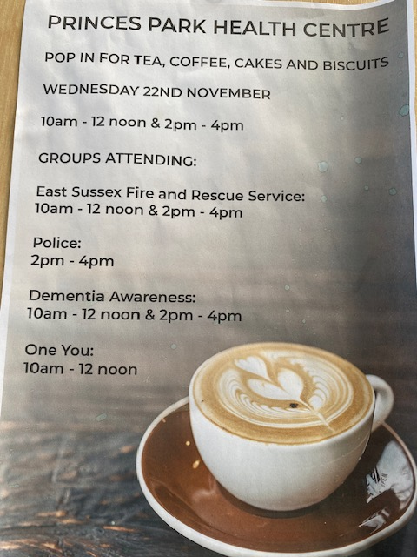
Slide 4
Latest PPG Coffee morning
The PPG hosted a coffee morning for patients and members of the public in July 2023. The PPG arranged for Sussex Police, Fire & Rescue service, Samaritans, Dementia Awareness
Our second coffee morning, which was held on Wednesday 22 November was a success. Lots of patients attended, and they enjoyed learning about Dementia Awareness and One You (stop smoking, and a lot of information from the Fire Service. Unfortunately, the Police were unable to come due to an emergency.

